Slide 1
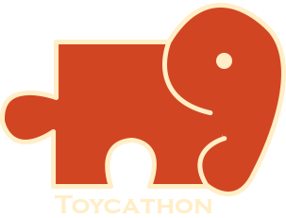

3D-Kurukshetra
A War Game

Slide 2
3D-Kurukshetra
Overview
Our idea is to create a game which can reflect one of the ancient Sanskrit epics of India i.e. Mahabharata
The game is going to be constructed based on military formations used in Mahabharat typically called as vyuhas
This is a war game between two teams having large no of soldiers ,each soldier has their own powers based on their ranking , experience , records etc.…
The game can have multiple levels in each level two teams have to crack their oponent’s vyuha’s and kill the enemies
Multiple users have to play this game by using appropriate strategies to crack the vyuhas and to win the game or to promote to next level.
Each level has different vyuhas ,the team can use the already existing strategies in proper situation to win the game
We allow organizations or individual developers to create their own strategies to crack the vyuhas if the strategy cracks the vyuha then the creators will get rewarded
Schema Select
1
Digital Toy
2
Theme of Our Toy:
Reintroducing the Indian intelligence behind many war strategies through Mahabharata and it aims to Improve Logical Thinking ,Problem Solving of the each player in the battle , we can say it will be the big Indian alternative for games like FreeFire and Pubg etc…

Slide 3
Create your Toy story
1
How Your Toy is Different From Existing Toys
Describe how your Toy/Game is different form existing games in the market and how you are going to commercialize it? (Not More Than 500 Words)
Our toy is completely based on Strategies used by our Indian ancestors and the modern strategies which are going to be developed to crack the earlier Strategies and the each soldier in the battle is a real player of our toy this is may not be available in existing War Games there may be exist some strategies defined by themselves but real players are may not be the soldiers they may be bots etc. The game involves Logical Thinking ,Problem Solving, Critical Thinking ,Team Play Moreover each and every concept is based on Indian Psychology, Intelligence, Culture, Ethos etc...Our game allows developers to create custom strategies to overcome the challenges they will get rewards based on no of captains used their strategies . We believe that our toy will be the great alternative for the battles games like FreeFire and Pubg etc.…
2
Does Your Toy Reflect Indian Culture, Ethos, Ayurveda, Diversity or Psychology
Tell us in detail how your toy cover the theme you’ve selected. Ne more specific towards crux or conclusion
Yes,The Heart of Out Toy was Mahabharath .The War Strategies are going to be taken from Kurukshetra Mahasangram which is a clear road map Indian for ethos ,virtues ,values and morals
Our Toy will completely design and develop based on our Indian Culture and Psychology each Player Virtual reality model will be designed like our Indian ancestors.
Our game toy will spread the Words Kurukshetra,Mahabharata,vyuhas,etc..

Slide 4
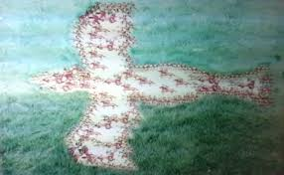
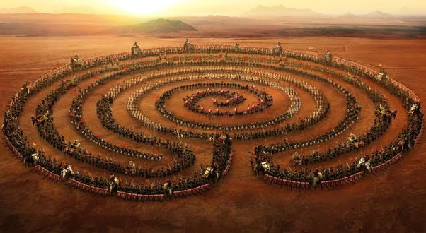
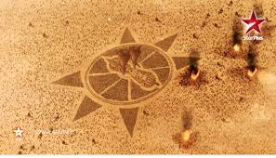
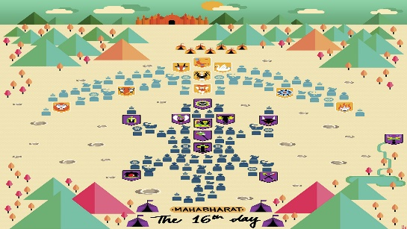
SOME CREATIVES
Map(india)
Battle1
… … … … … … … …
Kingdoms(states)
Captains
Catptain1
Catptain2
… … … …
Choose
Decision forwarding
…
Minister1
Minister2
Choose
Soldiers
Soldiers
Decision forwarding
Foramtions
The Beginning of the war…

Slide 5

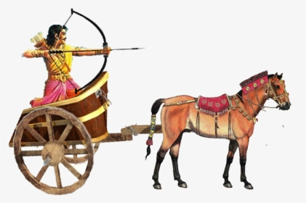
Team Profile
Team Objective:
Re-Introducing the Indian intelligence behind many war strategies through Mahabharata and it aims to Improve Logical Thinking ,Problem Solving of the each player in the battle,we can say it will be the big Indian alternative for games like FreeFire and Pubg etc…
Padmavyuh
Team Details:
Name Email Phone
1.S.Venkateswarlu venkateshsadam121@gmail.com 7095155796
2.B.LakshmiChaithanya lakshmichaitanya4c2@gmail.com 7893425820
3.V.SaiKiranKumar Reddy bunnyvijay77@gmail.com 7660908549
Team Size-3
Mentor: Dr.RadhaKrishnan
Pace Institute of Technology and Sciences
Type: TRACK-2
Sadam.Venkateswarlu
Signature

